Slide 1

Software validation via scalable path-sensitive value flow analysis
Minhao Zhan

Slide 2
Introduction
New algorithm for tracking the flow of values through a program
Path-sensitive
Scales to large programs

Slide 3
Motivation
Value flow analysis could be referred to
reaching definitions
flow analysis and closure analysis
strongest post-conditions
Which memory locations hold a given value of interest?

Slide 4
Value alias set
The value alias set for a given value of interest includes those expressions in the program that evaluate to the given value at a particular point [Nurit ACM 04]
The set of memory locations that hold a specific value
Example: pointers for a given value
*a -> “alias”
*b ->” alias”

Slide 5



value aliases vs. memory aliases
memory aliasing implies value aliasing
e1 and e2 are pointer expressions
memory aliasing =>
value aliasing =>

Slide 6
Data-flow analysis
Data-flow analysis is a technique for gathering information about the possible set of values calculated at various points in a computer program [wiki]

Slide 7
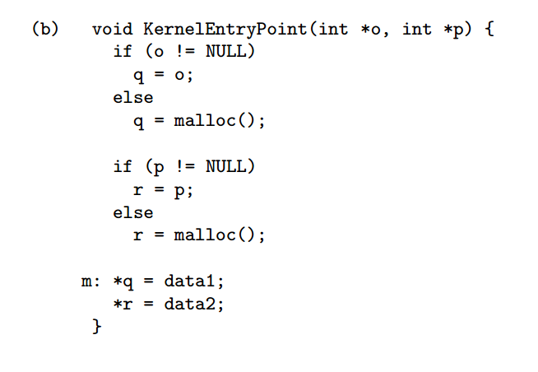
Example Code

Slide 8
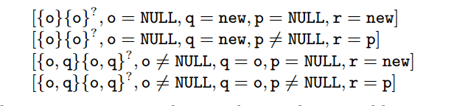
Full path-sensitive analysis
Path-sensitive analysis computes different pieces of analysis information dependent on the predicates at conditional branch instructions [wiki]
Example:

Slide 9
Full path-sensitive analysis
Parameter o
Parameter p
If(o!=null)
q = o
If(p!=null)
o!=null, q=o
p!=null,r=p
o!=null, q=o
p=null, r=new
q= malloc()
If(p!=null)
o=null,q=new p!=null, r=p
o=null, q=new
p=null,r=new

Slide 10

Standard dataflow analysis
Data-flow analysis is typically path-insensitive.
Symbolic states are merged at join points in the CFG(Control Flow Graph)
Example:

Slide 11
Standard dataflow analysis
Parameter o
Parameter p
If(o!=null)
q = o
If(p!=null)
o!=null, q=o
p!=null,r=p
o!=null, q=o
p=null, r=new
q= malloc()
If(p!=null)
o=null,q=new p!=null, r=p
o=null, q=new
p=null,r=new
Merge
*q = data1

Slide 12
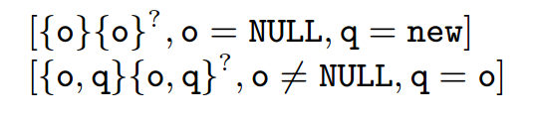
Value flow simulation
Track the value flow of parameters o and p independently
Compute and store value alias sets for only one parameter at a time
Example:

Slide 13
Value flow simulation
Parameter o
Parameter p
If(o!=null)
q = o
q= malloc()
*q = data1

Slide 14
Application
Probe security property
a user program may pass in pointers that point into the system reserved section, thereby duping the kernel into exposing or over-writing system data. [Nurit ACM 04]
Solution:
all user mode pointers must be “probed”, to ensure that they do not point into kernel memory, before they are dereferenced

Slide 15
Evaluation results
Validate the Windows operating system kernel (a million lines of code) against the Probe security property
500 input values(pointer parameters) tracked by ESP, leading to false error reports of 30 values, a failure rate of 6%.

Slide 16
Conclusion
Value flow simulation, a novel method for path-sensitive value flow analysis
Scalable enough to serve as an engine for software validation tools

Slide 17
Thank you!
Questions?

